Slide 1
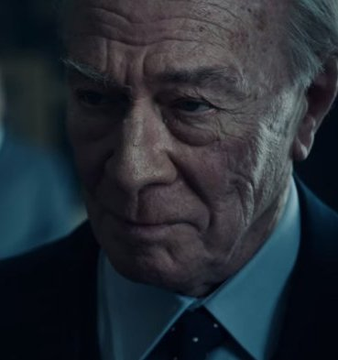
Christopher Plummer
Biography
Actor, Film Actor, Television Actor, Theater Actor (1929–)
Regarded as one of the most brilliant Canadian actors of his generation, Oscar-winner Christopher Plummer played Captain Von Trapp in the 1965 movie 'The Sound of Music,' among dozens of other projects.
Who Is Christopher Plummer?
Award-winning actor Christopher Plummer was born on December 13, 1929, in Toronto. He was classically trained as a stage actor and headlined for Britain's National Theatre, making his film debut in 1958's Stage Struck. Throughout his career, he has passed up blockbuster movies for smaller films. Nonetheless, he is probably best known as Captain Von Trapp in the 1965 musical movie The Sound of Music. Plummer has also won Tony Awards for his work in Cyrano (1973) and Barrymore (1997) and later won a supporting actor Oscar for the film Beginners

Slide 2
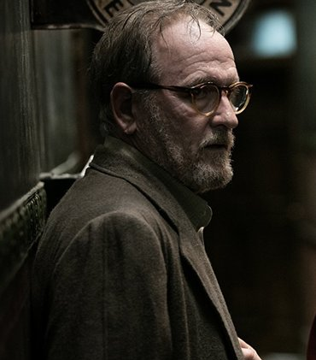
Richard Jenkins Biography Actor (1947–) Who Is Richard Jenkins? Born on May 4, 1947, Richard Jenkins has been seen in both minor and major character roles in movies and TV shows since the early 1980s. Some of his more memorable roles have been in Six Feet Under (2001-2005), The Visitor(2007), Burn After Reading (2008), Let Me In(2010), Olive Kitteridge (2014) and most recently, The Shape of Water (2017), in which he's been nominated for an Academy Award for Best Supporting Actor.

Slide 3
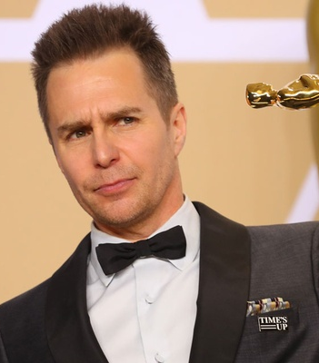
Sam Rockwell Biography Film Actor (1968–) American actor Sam Rockwell has starred in such films as 'Confessions of a Dangerous Mind' and 'The Hitchhiker’s Guide to the Galaxy.' He won his first Academy Award in 2018 for his role in 'Three Billboards Outside Ebbing, Missouri.' Who Is Sam Rockwell? Sam Rockwell is a versatile American actor with dozens of movie credits. Seen mainly in supporting roles, he has worked alongside such leading men and women as Tom Hanks (The Green Mile, 1999), Nicolas Cage (Matchstick Men, 2003), Brad Pitt (The Assassination of Jesse James by the Coward Robert Ford, 2007), Robert De Niro (Everybody’s Fine, 2009), Robert Downey Jr. and Scarlett Johansson (Iron Man 2, 2010) and Daniel Craig (Cowboys & Aliens, 2011). Rockwell emerged as a star in his own right with his Oscar-winning performance in Three Billboards Outside Ebbing, Missouri(2017).

Slide 4
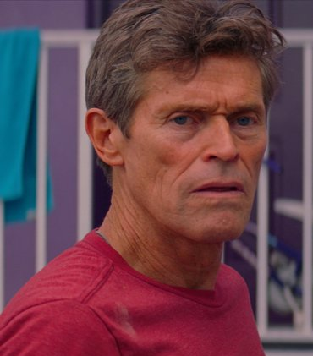
Willem Dafoe Biography Film Actor, Actor (1955–) Willem Dafoe is a gravelly voiced actor known for such films as 'Platoon,' 'The Last Temptation of Christ,' 'Spider-Man' and 'The Florida Project.' Who Is Willem Dafoe? Willem Dafoe made his film debut with a small part in Heaven's Gate (1980) and went on to the Oscar-nominated role of Sergeant Elias in Platoon (1986) and the controversial title role in The Last Temptation of Christ (1988). He also appeared in Born on the Fourth of July (1989),Tom and Viv (1994), The English Patient (1996) and Spider-Man (2002). Dafoe lent his voice to the heroic Gill in 2003’s Finding Nemo, and joined the cast of The Grand Budapest Hotel(2014), before earning awards buzz for The Florida Project (2017).

Slide 5
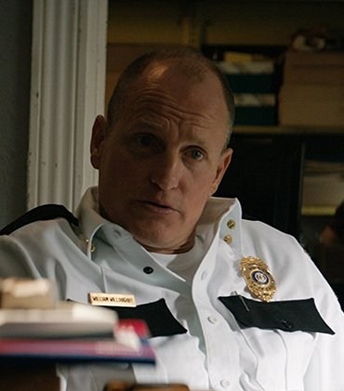
Woody Harrelson Biography Television Actor, Film Actor, Animal Rights Activist, Actor (1961–) Woody Harrelson is an actor known for his long-running role on TV's 'Cheers,' his films such as 'Natural Born Killers,' 'The People vs. Larry Flynt' and his breakthrough work on HBO's 'True Detective.' Who Is Woody Harrelson? Woody Harrelson's big break came in 1985, when he was cast as sweet, dim-witted bartender Woody Boyd on the wildly popular sitcom Cheers. His performance earned him five Emmy nominations and a win for Outstanding Supporting Actor in a Comedy Series. Harrelson moved into film and has had an impressive run, in films such as Natural Born Killers, The Thin Red Line, No Country for Old Men and the popular Hunger Gamesfranchise. Harrelson has also won accolades for his role on the HBO crime series True Detective.

Slide 6
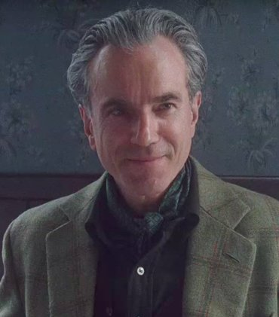
Daniel Day-Lewis Biography Film Actor, Theater Actor, Actor (1957–) English actor Daniel Day-Lewis is the only actor to win three Academy Awards for Best Actor. He earned Oscars for his roles in ‘My Left Foot,’ ‘There Will Be Blood’ and ‘Lincoln,' and nominations for 'Gangs of New York' and 'In the Name of the Father.' Who Is Daniel Day-Lewis? Daniel Day-Lewis was born on April 29, 1957, in London, England. He studied acting at the Bristol Old Vic and made his film debut in Sunday, Bloody Sunday. He was acclaimed for his role in My Beautiful Laundrette, and won Academy Awards for My Left Foot, There Will Be Blood and Lincoln. Day-Lewis married filmmaker Rebecca Miller, the daughter of photographer Inge Morath and playwright Arthur Miller, in 1996. The acclaimed performer announced his retirement from acting in June 2017.

Slide 7
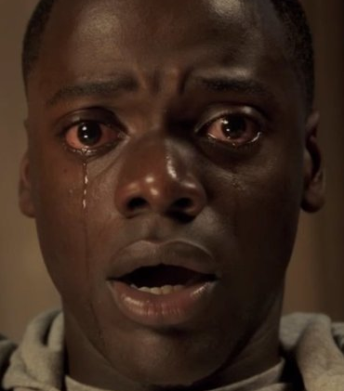
Daniel Kaluuya Biography Television Actor, Film Actor (1989–) Daniel Kaluuya is a British actor who became a breakout star in America in the racially charged horror film 'Get Out' in 2017. Who Is Daniel Kaluuya? Daniel Kaluuya is a black British actor who was seen mainly in English television shows until he was cast in the movie Get Out, his first lead role in an American movie. Released in 2017, the movie and Kaluuya were critically acclaimed and he became one of the year’s most notable breakout stars at the age of 29. In early 2018, he earned an Academy Award nomination for his performance in the film.

Slide 8
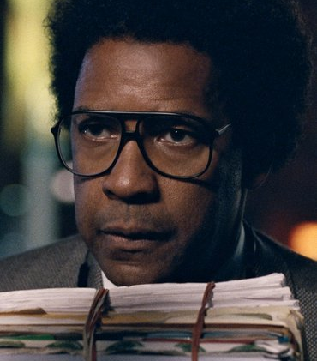
Denzel Washington Biography Film Actor, Actor, Television Actor, Filmmaker, Director (1954–) Former star of the hit TV drama 'St. Elsewhere,' actor/director Denzel Washington has earned popular and critical acclaim for his roles in an array of feature films, including 'Glory,' 'Malcolm X,' 'Training Day,' 'American Gangster' and 'Flight.' Who Is Denzel Washington? Born in Mount Vernon, New York, on December 28, 1954, Denzel Washington first studied journalism at Fordham University but then discovered an interest in acting. He made his feature film debut in the comedy A Carbon Copy (1981) and was cast on the hit TV medical drama St. Elsewhere (1982-8). He went on to appear in several hit movies, including Philadelphia, Man on Fire, The Book of Eli, American Gangster and Flight, and won Oscars for his roles in Glory and Training Day. He received an Oscar nomination for his starring role in 2016's Fences, an adaptation of August Wilson's Tony and Pulitzer Prize-winning play, and for the 2017 film Roman J. Israel, Esq.

Slide 9
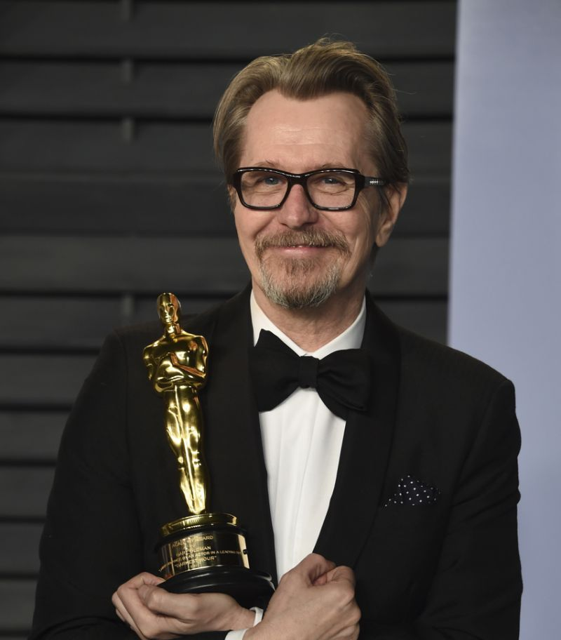
Gary Oldman Biography Actor, Director (1958–) Gary Oldman is an English actor and film director whose edgy, intense style has brought him acclaim in such hits as 'Sid and Nancy,' 'JFK,' 'The Dark Knight' and 'Darkest Hour.' Who Is Gary Oldman? Actor Gary Oldman was born in London, England, on March 21, 1958. From the moment his star first shined as Sex Pistols bassist Sid Vicious in Sid and Nancy (1986), Oldman has brought a raw, powerful edge to his roles, which have run the gamut from Dracula to Beethoven to Lee Harvey Oswald. He earned his first Oscar nomination for his work in the 2011 remake of Tinker, Tailor, Soldier, Spy, and claimed Golden Globe and Academy Award wins for his portrayal of Winston Churchill in Darkest Hour (2017).

Slide 10
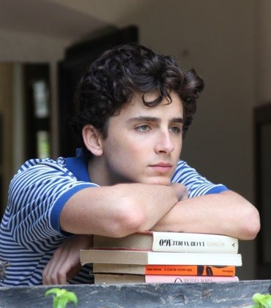
Timothée Chalamet Biography Actor (1995–) Timothée Chalamet is an American actor who's made a splash with films like 'Lady Bird' and 'Call Me By Your Name.' Who Is Timothée Chalamet? Timothée Chalamet (born December 27, 1995) received an Academy Award nomination as lead actor for his performance in the 2017 film Call Me By Your Name (which is also a contender for Best Picture). Chalamet's Oscar nod was announced on January 23, 2018, when he was 22, making him the youngest actor in this category since a 19-year-old Mickey Rooney was nominated for 1939's Babes in Arms. Chalamet has also appeared in the movies Lady Bird (2017) and Interstellar (2014), and had a multi-episode arc on the television show Homeland. His name reflects his French heritage, and he is fluent in that language.

Slide 11
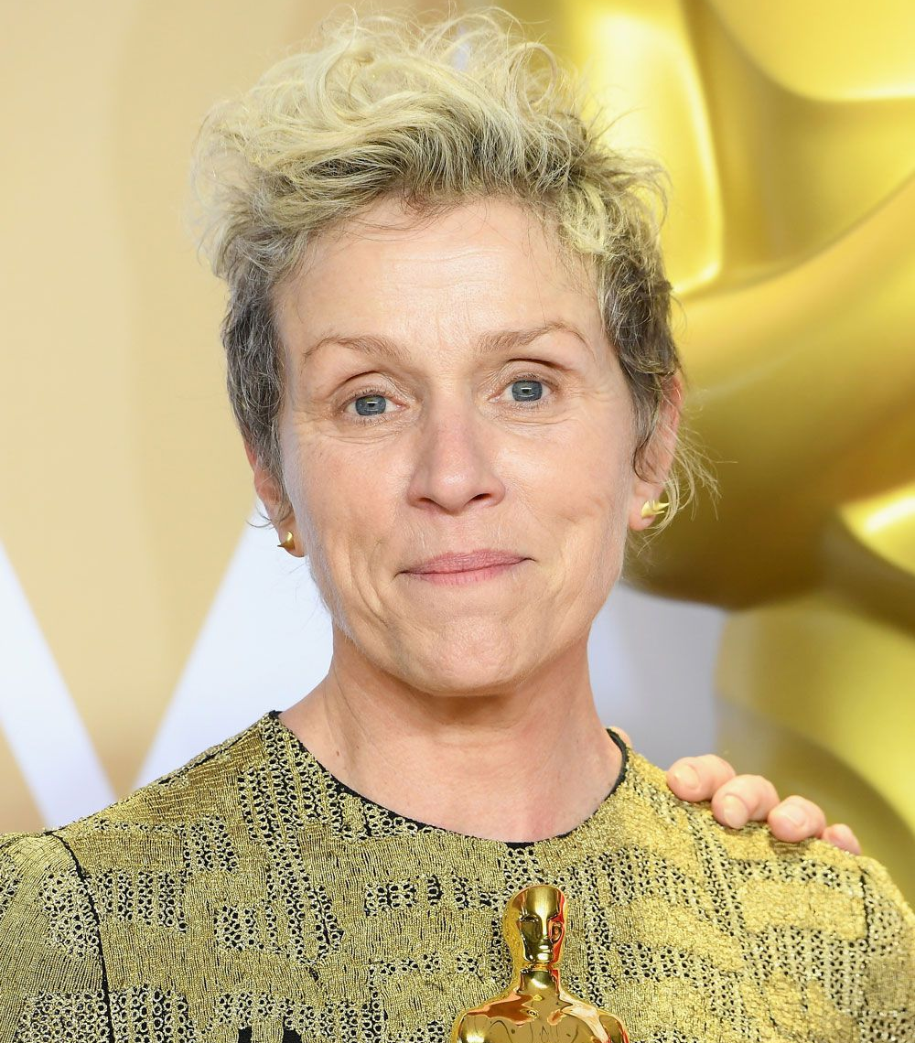
Frances McDormand Biography Film Actor/Film Actress, Television Actress, Film Actress, Actress (1957–) Actress Frances McDormand is known for her Oscar-winning roles in 'Fargo' and 'Three Billboards Outside Ebbing, Missouri,' as well as for acclaimed turns in 'Almost Famous' and the miniseries 'Olive Kitteridge.' Who Is Frances McDormand? Born in 1957 in Chicago, Illinois, Frances McDormand studied at Yale Drama School and shared a dorm room with Holly Hunter. She met Joel and Ethan Coen through Hunter and won a lead in their first film, Blood Simple. McDormand received her first Academy Award nomination for her role in 1988's Mississippi Burning and broke through with an Oscar for her memorable turn in 1996's Fargo. Along with her acclaimed roles in 2000's Almost Famous and 2005's North Country, McDormand earned an Emmy for the 2014 HBO miniseries Olive Kitteridge and later grabbed a second Best Actress Oscar for her performance in 2017's Three Billboards Outside Ebbing, Missouri.

Slide 12
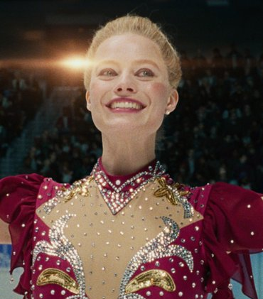
Margot Robbie Biography Actress, Producer (1990–) Margot Robbie is an Australian actress best known for her roles in 'The Wolf of Wall Street,' 'Suicide Squad' and 'I, Tonya.' Who Is Margot Robbie? Following in the footsteps of her Australian countrywomen Nicole Kidman and Cate Blanchett, Margot Robbie took the film world by storm, first in Martin Scorsese’s The Wolf of Wall Street (2013), along with memorable roles in The Big Short (2015) and Suicide Squad(2016). In 2017 she starred as the controversial figure skater Tonya Harding in the biopic I, Tonya.

Slide 13
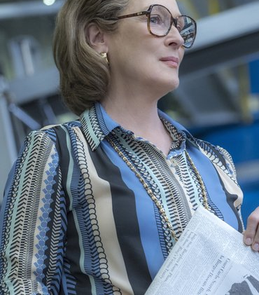
Meryl Streep Biography Film Actor/Film Actress, Film Actress, Actress (1949–) Oscar-winning actress Meryl Streep is one of the most esteemed stars of the screen, known for her work in such diverse films as 'Sophie's Choice,' 'The Deer Hunter,' 'The Devil Wears Prada,' 'Mamma Mia!' and 'Doubt.' Who Is Meryl Streep? Meryl Streep was born on June 22, 1949, in Summit, New Jersey. She began her career on the New York stage in the late 1960s and appeared in several Broadway productions. Streep transitioned to films in the 1970s and soon began earning major accolades, eventually winning Oscars for Kramer vs. Kramer, Sophie's Choice and The Iron Lady, among a league of nominations. Equally able to wow audiences in drama, comedy and musicals, she has come to be considered one of the greatest actresses of our time.

Slide 14
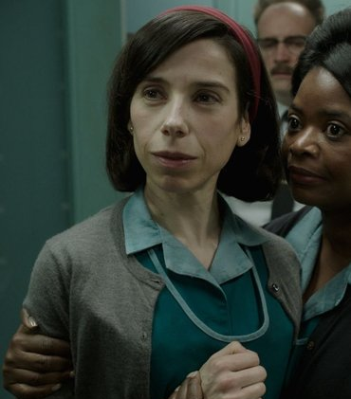
Sally Hawkins Biography Film Actress, Actress, Film Actor/Film Actress (1976–) Golden Globe-winning actress Sally Hawkins has appeared in several critically acclaimed films, including 'Happy-Go-Lucky,' 'Blue Jasmine' and 'The Shape of Water.' Who Is Sally Hawkins? Born in London, England, in 1976, actress Sally Hawkins studied her craft at the famed Royal Academy of Dramatic Art. A notable early film role came in Mike Leigh's All or Nothing (2002), and she later reteamed with Leigh for Happy-Go-Lucky (2008), for which she won a Golden Globe Award. Hawkins garnered more awards buzz for her work in Woody Allen's Blue Jasmine (2013), and Guillermo del Toro's The Shape of Water (2017).

Slide 15
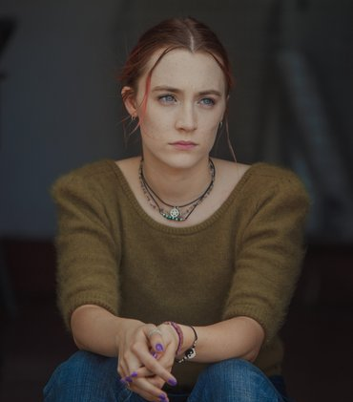
Saoirse Ronan Biography Film Actress, Television Actress, Film Actor/Film Actress, Actress (1994–) Oscar nominee Saoirse Ronan is an Irish-American actress best known for her roles in such films as 'Atonement,' 'The Lovely Bones,' 'Hanna' and 'Lady Bird.' Who Is Saoirse Ronan? Saoirse Ronan is an Irish-American actress born on April 12, 1994, in New York City. She began her career on the Irish television shows The Clinic and Proof, before delving into films in Hollywood. Ronan was featured in the 2007 movies I Could Never Be Your Woman and Atonement, the latter garnering her an Oscar nomination for best supporting actress. Other roles followed, including the lead in Peter Jackson's The Lovely Bones and the titular character of the action flick Hanna (2011). She received her second Oscar nomination for her lead role in the 2015 drama Brooklyn, and won a Golden Globe for her performance in the coming-of-age tale Lady Bird (2017).

Slide 16
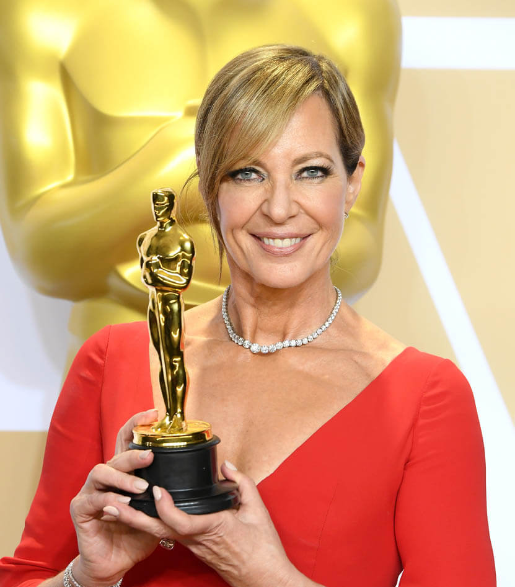
Allison Janney Biography Film Actress, Television Actress, Theater Actress (1959–) Allison Janney is an Emmy- and Academy Award-winning actress known for a huge array of projects, ranging from series such as 'The West Wing' and 'Mom' to films like 'The Hours', 'Juno,' 'Hairspray' and 'I, Tonya.' Who Is Allison Janney? Born on November 19, 1959, in Dayton, Ohio, aspiring athlete Allison Janney eventually pursued an acting career, earning accolades for roles that would encompass stage, film and television. She won four Emmys for her part as press secretary C.J. Cregg on the acclaimed series The West Wing, and later won additional awards for Masters of Sex and Mom. In addition to her work on productions of A View From the Bridge and 9 to 5, Janney has appeared in films like American Beauty, The Hours, Juno, Away We Go and I, Tonya, the last of which produced her first Oscar win in 2018.

Slide 17
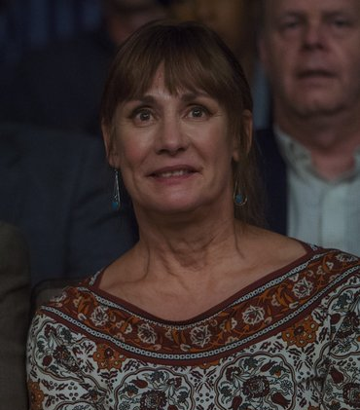
Laurie Metcalf Biography Film Actress, Theater Actress, Television Actress (1955–) American actress Laurie Metcalf is known for her theater work and award-nominated roles on such TV programs as 'Roseanne,' 'The Big Bang Theory' and 'Getting On.' Who Is Laurie Metcalf? Born in Illinois in 1955, Laurie Metcalf became an original ensemble member of the Steppenwolf Theatre Company in the 1970s. After generating buzz as a stage actress, she earned widespread attention through her Emmy-winning role of Jackie on the popular 1990s sitcom Roseanne. Metcalf joined the all-star cast for the animated hit Toy Story (1995) and its sequels, and drew praise for her work in TV programs like The Big Bang Theory and Getting On. She has also remained heavily involved in the theater, earning Tony Award consideration for her performances in November and Misery

Slide 18
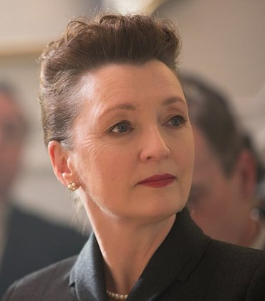
Lesley Manville Biography Actress (1956–) Lesley Manville is a veteran British stage-and-screen actress who received her first-ever Oscar nomination in 2018 for the film 'Phantom Thread,' starring Daniel Day-Lewis. Who Is Lesley Manville? Born in 1956, Lesley Manville has enjoyed a long career as an actress based in England. She has worked steadily in English television since the 1970s, while also appearing in movies, including seven directed by Mike Leigh – Mr. Turner (2014), Another Year (2010), Vera Drake(2004), All or Nothing (2002), Topsy-Turvy(1999), Secrets & Lies (1996) and High Hopes(1988).

Slide 19
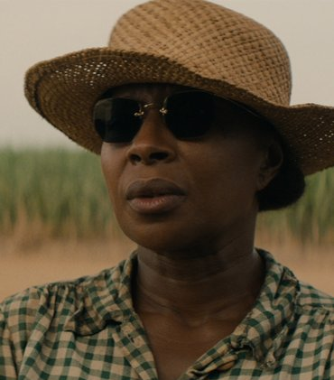
Mary J. Blige Biography Singer (1971–) 'Queen of Hip-Hop Soul' Mary J. Blige has influenced a generation of artists with hits like 'Real Love' and 'Be Without You.' She has also had a successful acting career, including playing Betty Shabazz in the TV movie 'Betty & Coretta.' Who Is Mary J. Blige? Mary J. Blige was born on January 11, 1971, in the Bronx, New York. When a recording of the 17-year-old Blige singing at a karaoke booth came to the attention of Uptown Records, the company put her under contract immediately. She sang backup until the 1992 release of her first solo album, What's the 411?, a record that re-defined modern soul. Blige has had several No. 1 Billboard hits and has won nine Grammy Awards. She has also earned positive reviews for her acting in projects such as the 2013 TV movie Betty & Coretta and the 2017 World War II-era drama Mudbound.

Slide 20
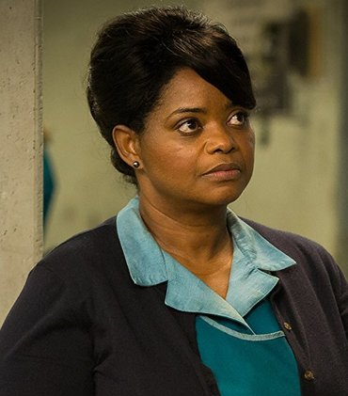
Octavia Spencer Biography Actress, Television Actress, Film Actor/Film Actress, Film Actress (1972–) After years of scene-stealing small acting roles, Octavia Spencer rose to fame with her award-winning performance in 2011's 'The Help.' Who Is Octavia Spencer? Born and raised in Alabama, Octavia Spencer landed her first acting role while working behind the scenes of 1996's A Time to Kill. She then moved to Los Angeles, where she landed small parts in films and TV series like City of Angels and The Chronicle. In 2011, her career reached new heights with the hit dramatic film The Help, which earned her an Academy Award. After her Oscar win, she appeared in films like Fruitvale Station (2013), Get on Up(2014), Black or White (2014), and Insurgent(2015) and Allegiant (2016) in the Divergentseries. Spencer received Golden Globe and Oscar nominations for her portrayal of NASA mathematician Dorothy Vaughan in the 2016 biopic Hidden Figures, as well as for her supporting role in the 2017 dark fantasy The Shape of Water.

